Slide 1
Number Theory

Slide 2
What is number theory?
Number theory is a branch in mathematics that deals with the study of integers and integer-valued functions.
It involves studies related to prime numbers and properties of mathematical concepts such as rational numbers.

Slide 3
Importance of number theory in computer algorithms
Number theory is used in various computer applications for coding, random number generation, cryptography, and graphics.
Questions on number theoretic concepts are also asked in competitive programming interviews and quizzes.
So, programmers need to know the basic concepts of number theory.

Slide 4
Number theory algorithms
Number theory algorithm is a category in data structure and algorithms that involve studies related to algorithms in number theory.
Such algorithms are used to conduct tests such as primality testing. A primality test is an algorithm that verifies whether a number is a prime or not.

Slide 5
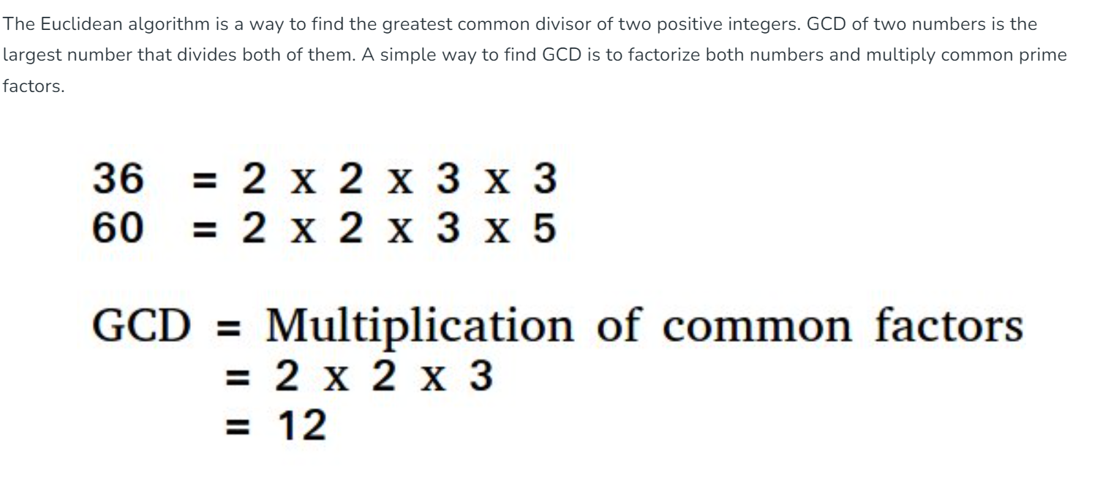
GCD and LCM
Euclidean algorithms (Basic and Extended)

Slide 6
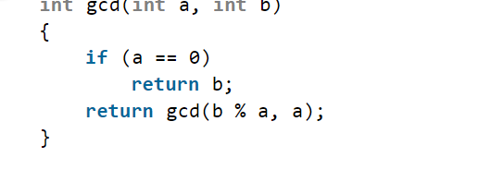
Basic Euclidean Algorithm for GCD:
The algorithm is based on the below facts.
if we divide the smaller number, the algorithm stops when we find the remainder 0.
Time Complexity: O(Log min(a, b))

Slide 7
Extended Euclidean Algorithm:
Extended Euclidean algorithm also finds integer coefficients x and y such that: ax + by = gcd(a, b)

Slide 8
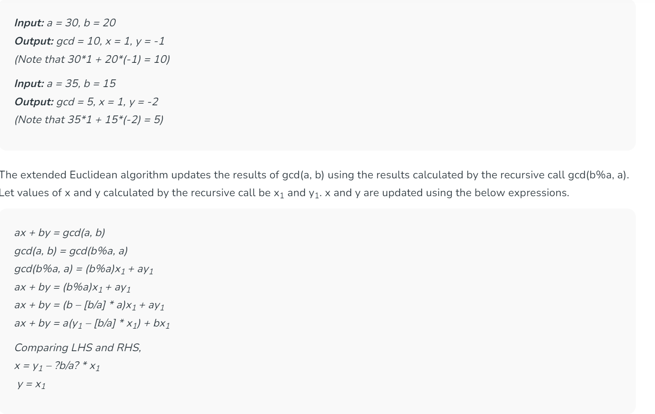

Slide 9
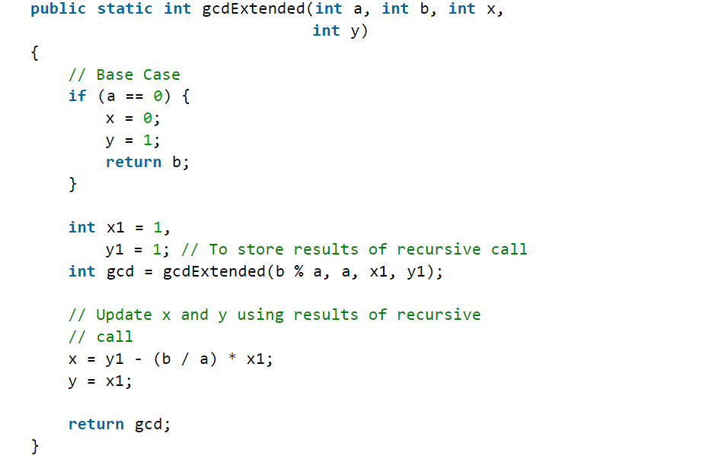
Time Complexity: O(log N)

Slide 10
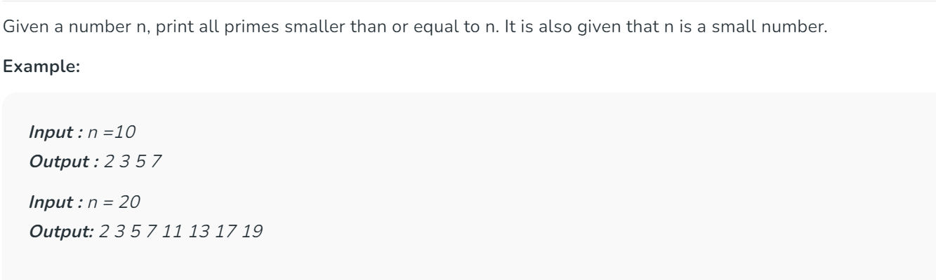
Sieve Method.

Slide 11
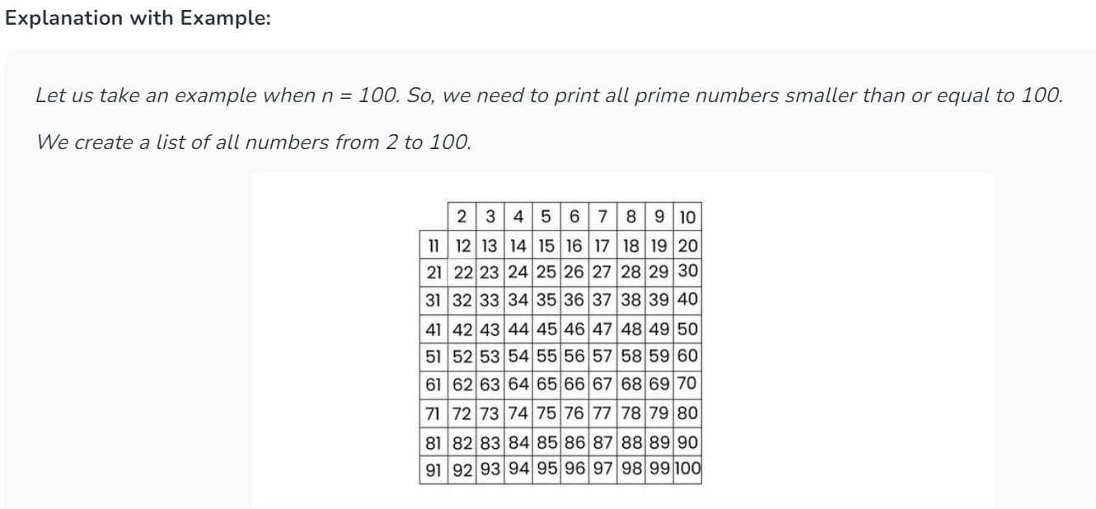

Slide 12
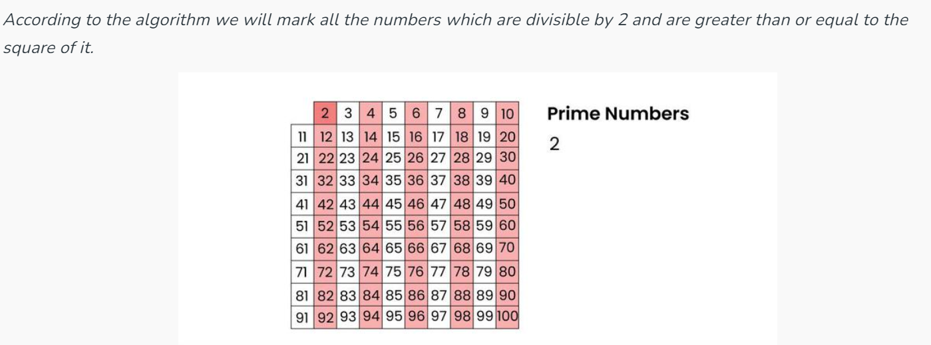

Slide 13
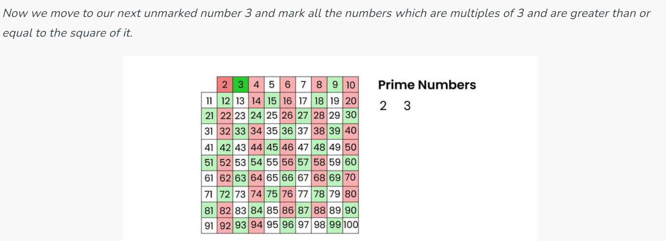

Slide 14
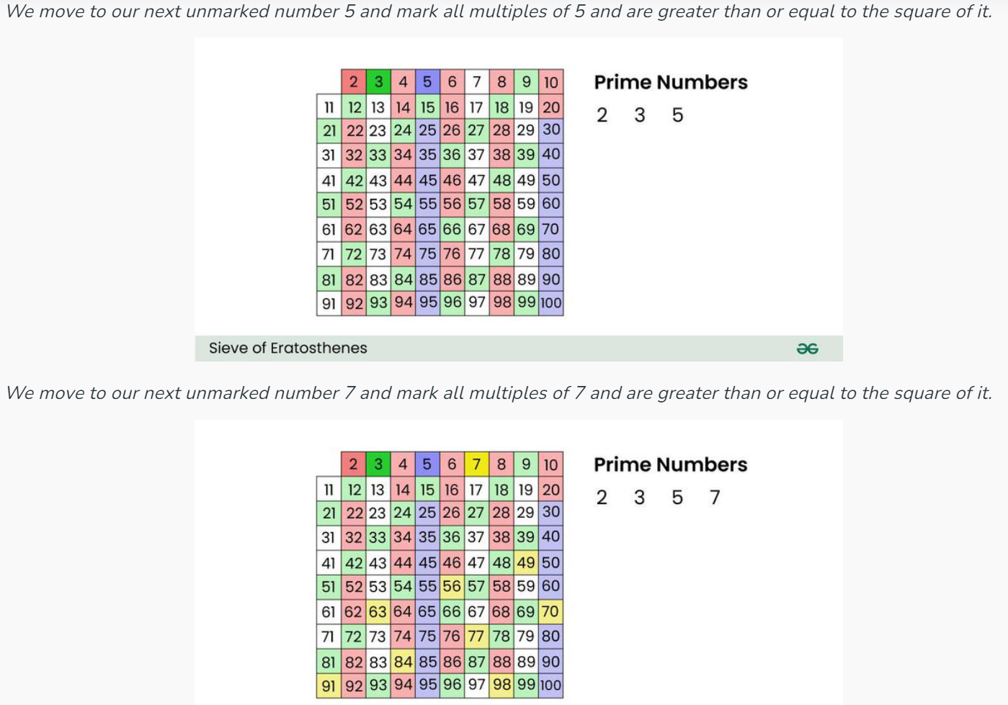

Slide 15
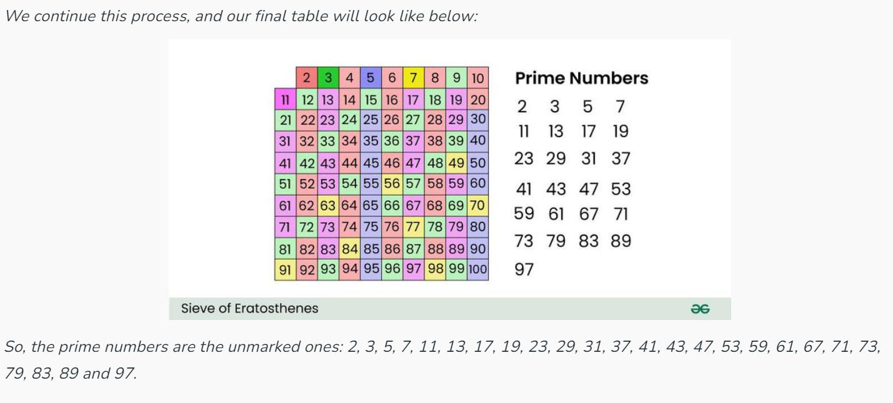

Slide 16
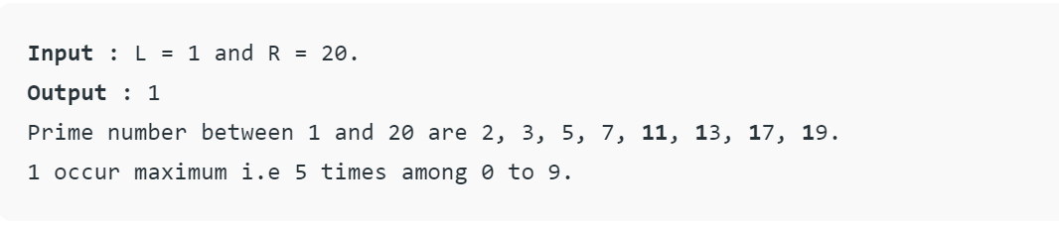
Find the highest occurring digit in prime numbers in a range

Slide 17
The idea is to start from L to R, check if the number is prime or not. If prime then increment the frequency of digits (using array) present in the prime number. To check if the number is prime or not we can use the Sieve method

